Slide 1
Locker Rentals Website
Ahmed Alharbi
Colton Buster

Slide 2
Problem
TUB locker rentals
Must contact Office of Campus Life
No method for checking availability

Slide 3
Solution
Locker rental site
Login as student or admin
Students can view available lockers and rent one through the website
Administrators can see which lockers have been rented out and by whom

Slide 4
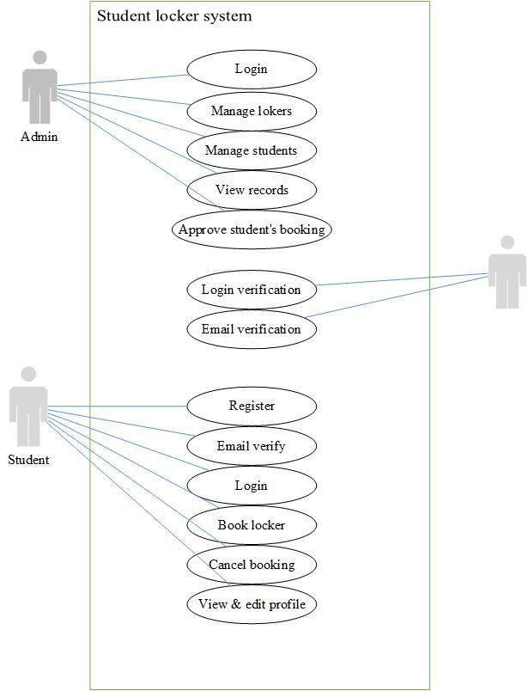

Slide 5
Home Page
Displays locker tiles
Includes counts of total, available, and damaged

Slide 6
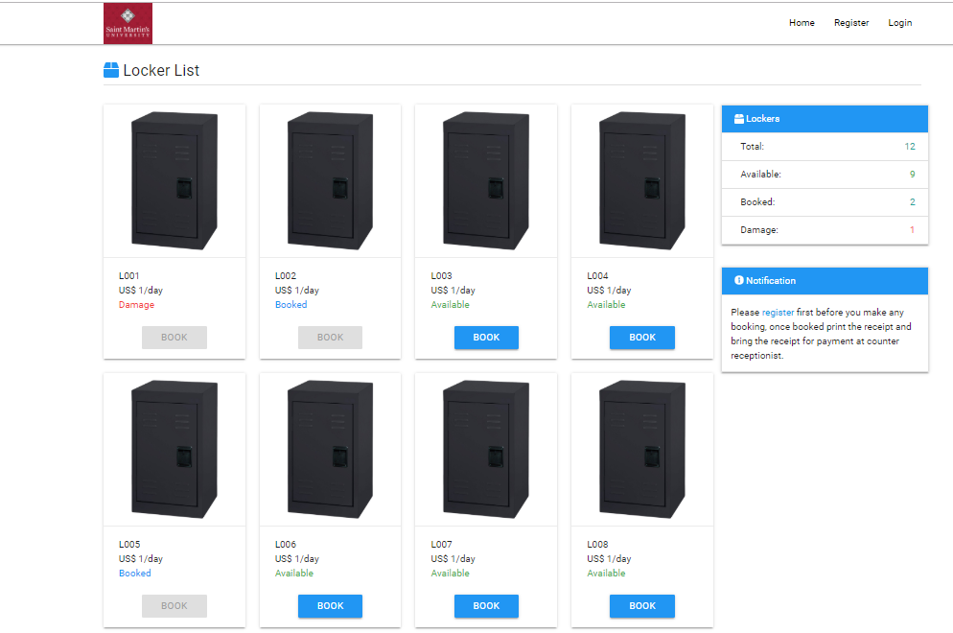

Slide 7
Registration/Login
Create account
Confirmation email
Separate student and admin login

Slide 8
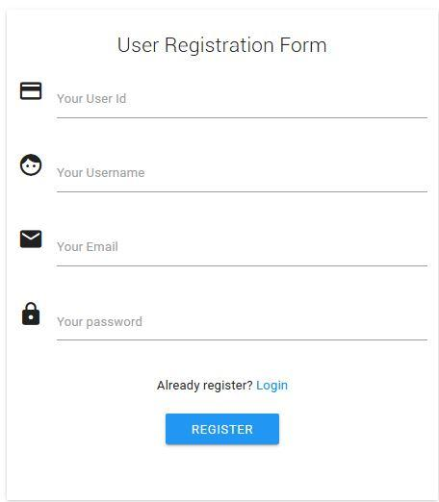

Slide 9
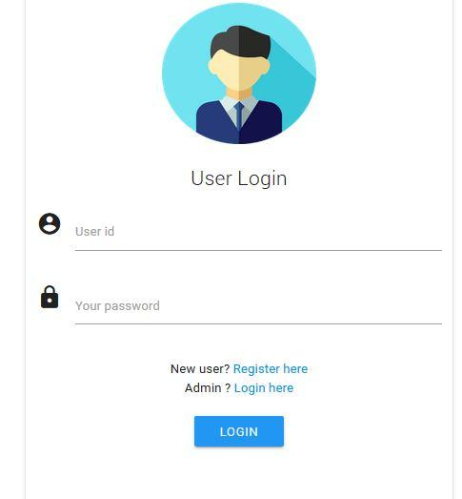

Slide 10
Booking
Choose from any available lockers
Receipt emailed to account that must be taken to TUB office

Slide 11
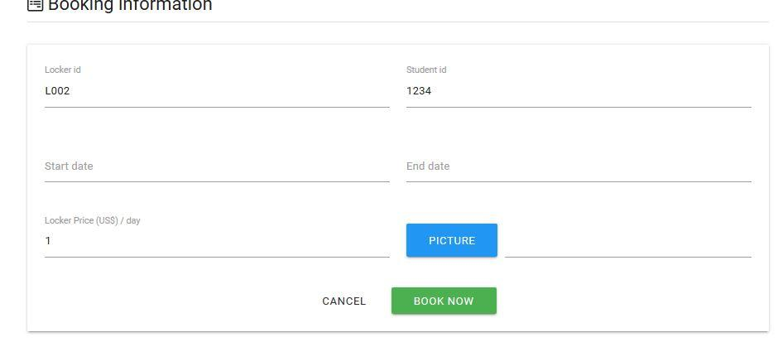

Slide 12
Admin
Dashboard
Active/total users
Total lockers booked
Add/update lockers
Records

Slide 13
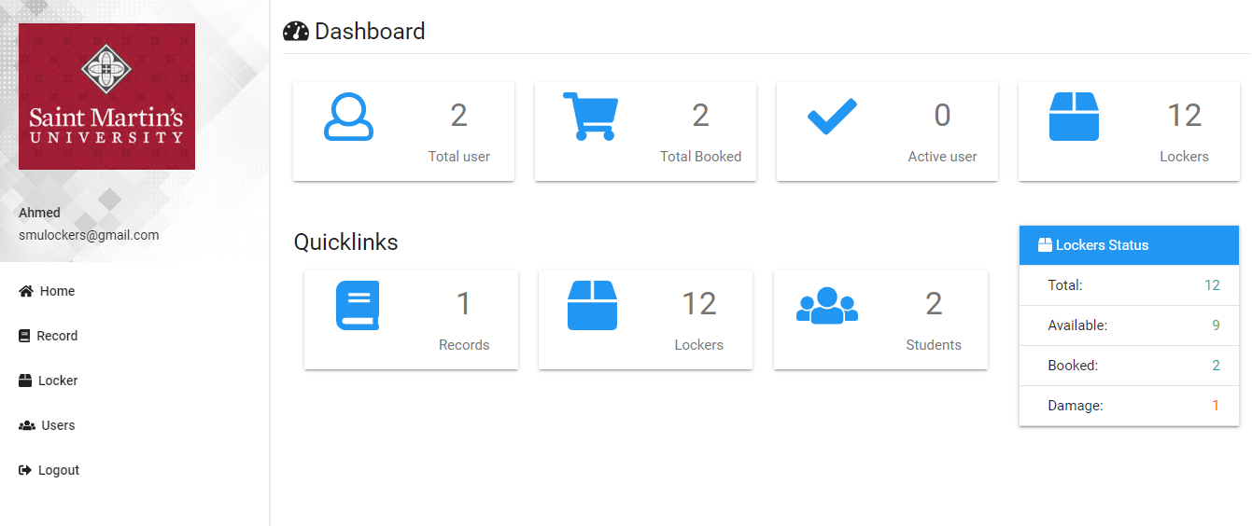

Slide 14
Thank you

